Slide 1

Te rejat e fundit ne ProFisc & Ndryshimet Legjislative 2026
New developments on Profisc & New Legislative changes 2026

Slide 2
Ligji 79/2025: PËR DISA NDRYSHIME DHE SHTESA NË LIGJIN NR. 9920, DATË 19.5.2008, “PËR PROCEDURAT TATIMORE NË REPUBLIKËN E SHQIPËRISË”, I NDRYSHUAR
Në nenin 59 bëhen ndryshimi dhe shtesa e mëposhtme:
Pika 1 ndryshohet si më poshtë:
“1. Tatimpaguesit, personat fizikë, individë tregtarë e të vetëpunësuar apo entitetet nuk mund të kryejnë ndërmjet tyre transaksione shitjeje ose blerjeje me para në dorë kur vlera e transaksionit është më e madhe se 100 000 lekë.”.
Pas pikës 2 shtohet pika 3 me këtë përmbajtje:
“3. Personat fizikë, individë tregtarë e të vetëpunësuar apo entitetet nuk mund të kryejnë transaksione shitjeje ose blerjeje me para në dorë me individë kur vlera e transaksionit është më e madhe se 500 000 lekë.”
Article 59, the following amendment and addition are made:
Point 1 is amended as follows:
“1.Taxpayers, commercial and self-employed individuals or entities may not carry out sales or purchase transactions with cash between them when the transaction value is greater than 100,000 ALL.”
After point 2, point 3 is added with the following content:
“3. Natural persons, commercial and self-employed individuals or entities may not carry out sales or purchase transactions with cash with individuals when the transaction value is greater than 500,000 ALL.”
1/2

Slide 3
Ligji 83/2025 PËR DISA NDRYSHIME NË LIGJIN NR. 87/2019, “PËR FATURËN DHE SISTEMIN E MONITORIMIT TË QARKULLIMIT”, I NDRYSHUAR
Fjalia e dytë, e pikës 2, të nenit 9, ndryshohet si më poshtë:
“Nëse blerësi është individ i paregjistruar si subjekt për ushtrim aktiviteti tregtar, në faturë shënohet emri i tij i plotë, numri personal i identifikimit ID dhe adresa e saktë ku dërgohen mallrat.”
Pika 2, neni 17:
Cdo tatimpagues qe leshon fature duhet te shqyrtoje te dhenat ne librin e shitjeve dhe librin e blerjeve deri ne “ditën e njëmbëdhjetë te muajit per faturat e leshuara e te pranuara qe I perkasin muajit paraardhes, dhe, nese eshte e nevojshme t'i plotesoje ato me informacion shtese. Pas perfundimit te kesaj procedure duhet te konfirmoje saktesine e te dhenave.
Në fjalinë e parë, të pikës 10, të nenit 20, mbi proceduren e fiskalizimit te fatures per importet e mallrave, fjalët “tri ditë” zëvendësohen me fjalët “shtatë ditë”.
The second sentence, point 2, of Article 9, is amended as follows:
“If the buyer is an individual not registered as a subject for exercising commercial activity, the invoice shall state his full name, personal identification number ID and the exact address where the goods are sent.”
Point 2, Article 17:
Every taxpayer who issues invoices shall examine the data in the sales book and the purchases book until the “eleventh day of the month for invoices issued and received that belong to the previous month, and, if necessary, complete them with additional information. After completing this procedure, he shall confirm the accuracy of the data.
In the first sentence, point 10, of Article 20, on the procedure for fiscalizing invoices for imports of goods, the words “three days” are replaced by the words “seven days”.
2/2

Slide 4

ProFisc 2026 Zhvillime te reja New Developments

Slide 5
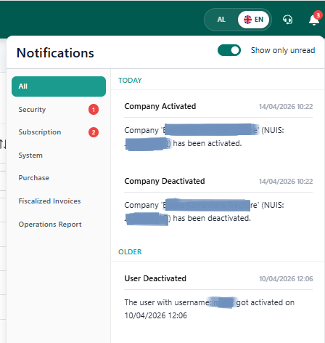
Menu e re Njoftimet Nje menu e re i shtohet Profisc me te gjitha njoftimet per kompanine tuaj e cila perfshin: 1. njoftime mbi abonimet, paketen, aktivizime, etj 2. njoftime mbi faturat e reja te blerjes 3. njoftimet mbi faturat e shitjes te refuzuara nga bleresi 4. njoftime mbi aktivizimin/c'aktivizimin e perdoruesve te kompanise suaj 5. njoftime operacionale dhe te tjera New Notifications menu A new menu is added to Profisc with all the relevant notifications for your company which includes:
1. notifications on subscriptions, packages, activations, etc.
2. notifications on new purchase invoices
3. notifications on sales invoices rejected by the buyer
4. notifications on activation/deactivation of your company's users
5. operational and other notifications
1/4

Slide 6
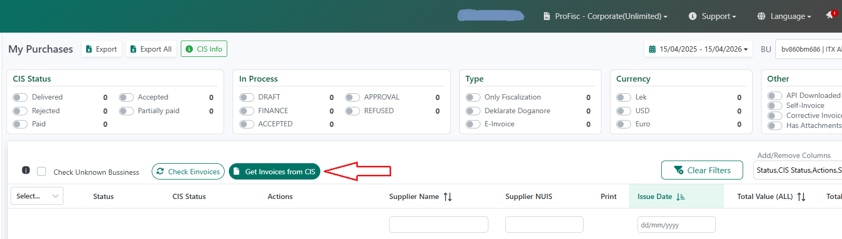
Sherbimi i marrjes se faturave te shitjes/blerjes nga Platforma Qendrore Butoni Merr faturat nga CIS ofron mundesine e marrjes se faturave te shitjes dhe blerjeve te subjektit direkt nga Platforma per periudhen kohore te zgjedhur nga perdoruesi. Ne kete menyre Librat e Shitjes dhe te Blerjes ne Profisc do te pasurohen me faturat e reja te cilat krahasohen me ato te ruajtura ne sistem duke njehsuar faturat e ardhura rishtas, apo fatura per tu verifikuar.
New Web Service GetInvoices from CIS now available on Profisc
Get Invoices from CIS button offers the possibility of receiving the entity's sales and purchase invoices directly from the Platform for the time period selected by the user.
In this way, the Sales and Purchase Books in Profisc will be enriched with new invoices which are compared with those stored in the system by counting newly received invoices, or invoices to be verified.
2/4

Slide 7
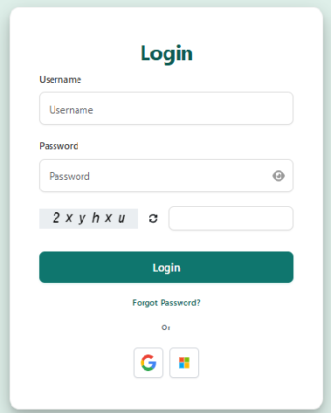
Autentikimi ne ProFisc - SSO me Google apo MS 365 ProFisc ofron mundesi autentikimi SSO me account te perdoruesit ne Google apo MS 365 Per me shume ju lutemi te ndiqni instruksionet ne link: https://help.profisc.al/autentikimi-sso-me-microsoft-365-ne-profisc-udhezime-per-implementim/ ProFisc offers SSO authentication options with users' accounts Google or MS 365.
Please follow instructions on link: https://help.profisc.al/autentikimi-sso-me-microsoft-365-ne-profisc-udhezime-per-implementim/
3/4

Slide 8
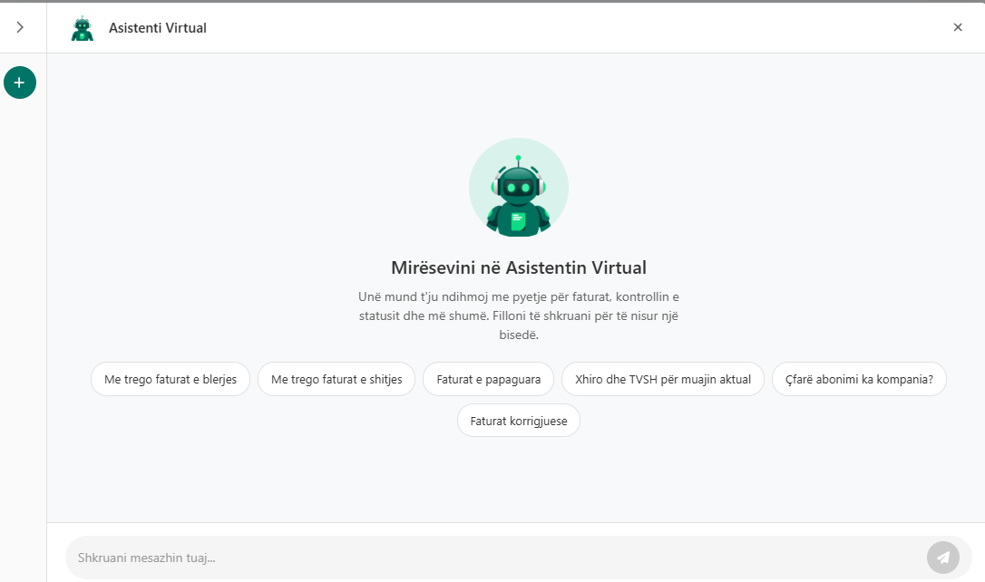
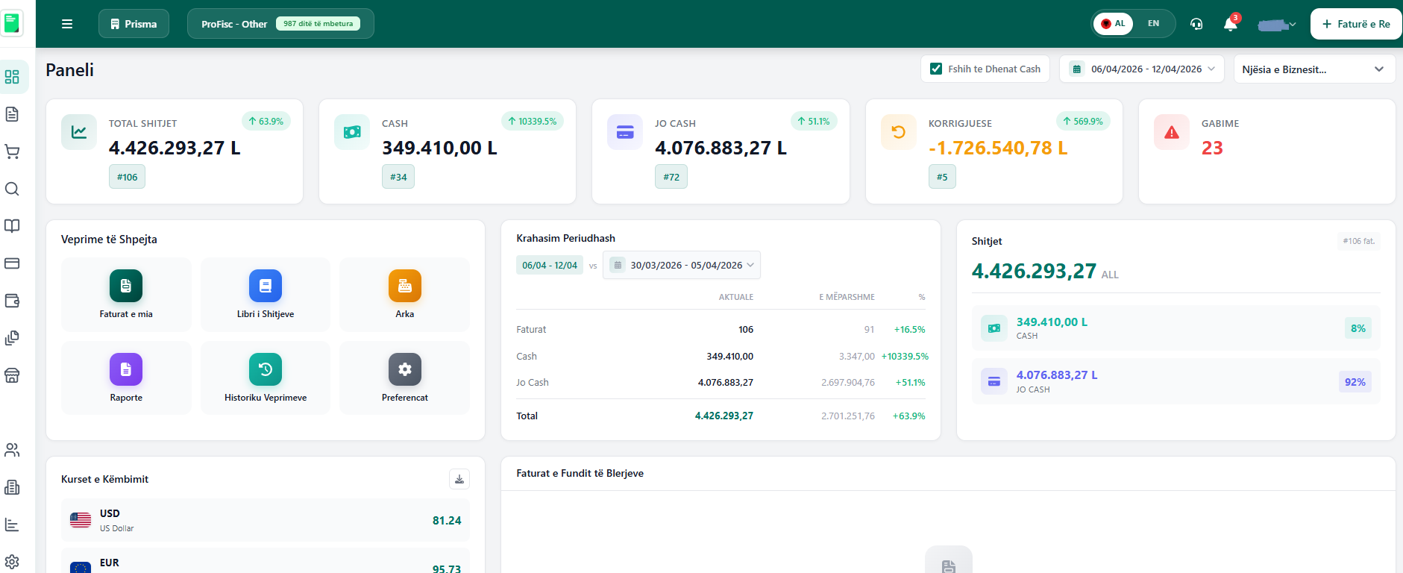
Coming Soon... New redesigned interface New ProFisc building assistant
4/4

Slide 9

ProFisc + Open Banking Sherbime te reja te pagesave ofruar nga Profisc & BKT
ProFisc + Open Banking New E-Services on Payments provided by Profisc & BKT
1. Urdher Pagesat/Payment Orders
2. Njoftimet e pagesave/Payment Receipts
3. Pagat / Salary Payment Order
4. Transaksionet Bankare / Bank Transactions

Slide 10
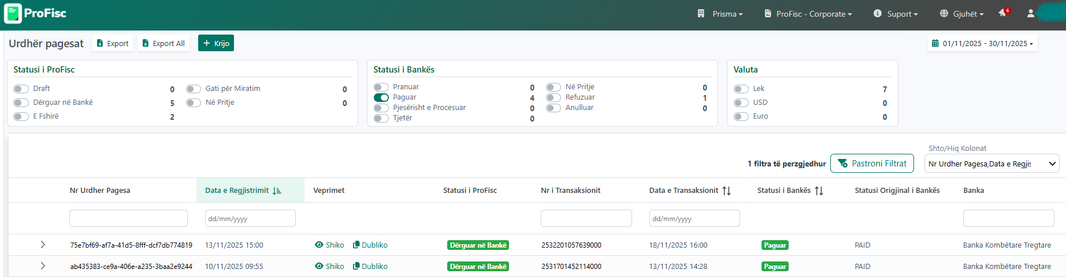
Urdher Pagesat e Faturave te Blerjes Ju mund te inicioni direkt ne ProFisc Urdher Pagesa drejt BKT per faturat tuaja te blerjes (elektronike ose jo). Per kete qellim: 1. ProFisc mundeson ruajtjen e te dhenave te furnitoreve tuaj. 2. Ju mund te zgjidhni direkt nga menuja Faturat e Blerjes faturat qe doni te pagoni. 3. Draft Urdher Pagesa krijohet menjehere duke paraplotesuar te gjitha te dhenat e ekstraktuara nga vete faturat. 4. Urdher Pagesa e aprovuar ne ProFisc dergohet drejt BKT nepermejt Web Service-ve te ngritura per kete qellim. 5. Ne llogarine E-Banking te subjektit Urdher Pagesa gjendet ne menune Transaksionet fiskale ne pritje 6. Perdoruesi ne E-Banking aprovon apo refuzon pagesen. 7. Statusi i Urdher Pageses perditesohet ne kohe reale nga BKT drejt ProFisc duke paraqitur edhe te dhenat e transaksionit ne BKT (numer / date). Per me shume informacion ju lutemi vizitoni https://help.profisc.al/si-te-iniciojme-nje-pagese-fature-blerje-ne-profisc/
1/8

Slide 11
Purchase Invoices Payment Orders You can initiate a Payment Order directly in ProFisc towards BKT for your Purchase invoices (electronic or not).
For this purpose:
1. ProFisc enables managing (add, edit) all your suppliers' data.
2. You can directly select from the Purchase Invoices menu the invoices you want to pay.
3. The Draft Payment Order is created by pre-filling all the data extracted from the invoices themselves.
4. The Payment Order approved in ProFisc is sent towards BKT through the Web Services set up for this purpose.
5. In the subject's E-Banking account, the Payment Order is found in the Pending Fiscal Transactions menu.
6. The user in E-Banking approves or rejects the payment.
7. The Payment Order status is updated in real time from BKT towards ProFisc among other data showing the transaction in BKT (number & date). For more information, please visit https://help.profisc.al/si-te-iniciojme-nje-pagese-fature-blerje-ne-profisc/
2/8

Slide 12
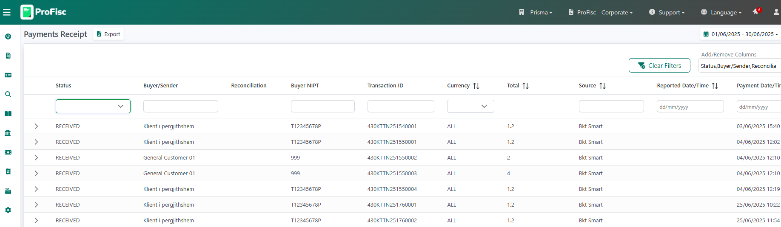
Njoftimet e pagesave Ky sherbim ben te mundur dergimin e njoftimit ne kohe reale per pagesa CASH te faturave te fiskalizuara nga ProFisc dhe te paguara nga BKT Smart e klienteve konsumatore. Ky sherbim parashikon: 1. Pagesen e fatures se fiskalizuar nga ProFisc nepermjet BKT Smart duke skanuar kodin QR te fatures. 2. ProFisc merr ne kohe reale te dhenat e pageses se kesaj fature nga BKT dhe perditeson statusin e pageses se fatures ne ProFisc. 3. ProFisc dergon njoftim ne sistemin ERP te Tregtarit per statusin e fatures se perditesuar.
3/8

Slide 13
Payment Receipts This service enables sending real-time notifications for CASH payments of invoices fiscalized by ProFisc and paid by BKT Smart of consumer clients.
This service includes:
1. Payment of the invoice fiscalized by ProFisc through BKT Smart by scanning the QR code of the invoice.
2. ProFisc receives in real time the payment data of this invoice from BKT and updates the invoice payment status in ProFisc.
3. ProFisc sends a notification to the Merchant's ERP system for the updated invoice status.
4/8

Slide 14
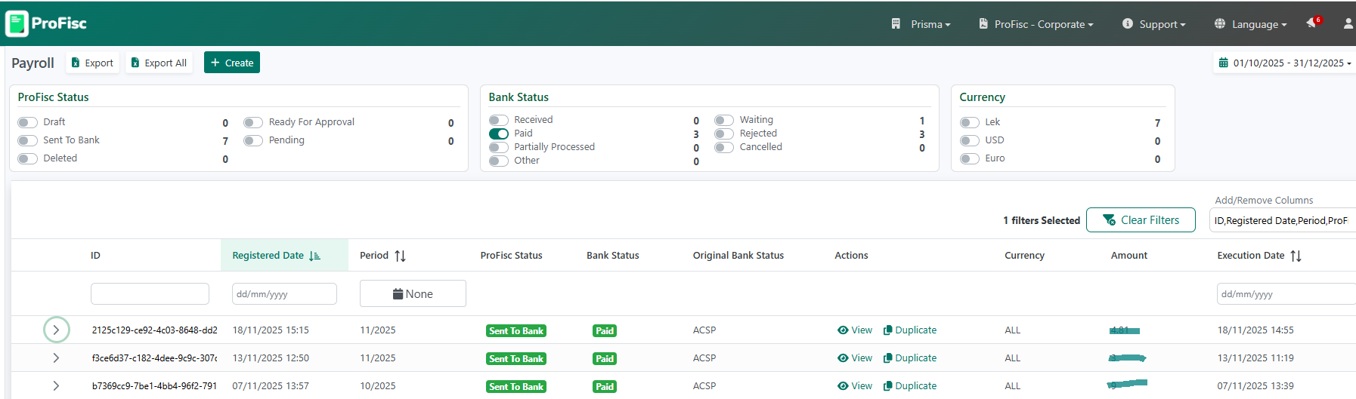
Pagat Ky sherbim i ofron subjektit mundesine e dergimit te Urdher Pageses se Pagave nga ProFisc drejt llogarise E-Banking te tij prane BKT. 1. ProFisc mundeson ruajtjen e te dhenave te punonjesve tuaj. 2. Ju mund te krijoni nje Draft Urdher Pagese per Pagat direkt ne ProFisc duke ngarkuar punonjesit nje nga nje ose duke upload listen e tyre. Mund te perdorni dhe funksionin Dubliko prej nje Urdher Pagese te Pagave ekzistues ne sistem. 3. Ky sherbim parashikon qe llogarite perfituese (te punonjesve) mund te jene ne banka te ndryshme apo ne monedha te ndryshme 4. Urdher Pagesa e Pages e aprovuar ne ProFisc dergohet drejt BKT nepermejt Web Service-ve te ngritura per kete qellim. 5. Ne llogarine E-Banking te subjektit Urdher Pagesa e Pagave gjendet ne menune Pagat/Aprovimet e Pagave ne Pritje 6. Perdoruesi ne E-Banking ne BKT aprovon Urdher Pagesen. 7. Statusi i Urdher Pageses perditesohet ne kohe reale nga BKT drejt ProFisc duke paraqitur detajet per cdo rekord (punonjes). Per me shume detaje ju lutemi vizitoni: https://help.profisc.al/si-te-iniciojme-nje-urdher-pagese-per-paga-express/
5/8

Slide 15
Salary Payment Order You can initiate a Salary Payment Order directly in ProFisc towards your business E-banking account in BKT 1. ProFisc enables the storage of your employees' data.
2. You can create a Draft Salary Payment Order directly in ProFisc by loading employees one by one or by uploading their list. You can also use the Duplicate function of an existing Salary Payment Order in the system.
3. The beneficiary accounts (of employees) can be in different banks and in different currencies.
4. The Salary Payment Order approved in ProFisc is sent to BKT through the Web Services set up for this purpose.
5. In the subject's BKT E-Banking account, the Salary Payment Order is found in the Salaries/Pending Salary Approvals menu.
5. The user in E-Banking at BKT approves the Payment Order.
5. The status of the Payment Order is updated in real time from BKT to Profisc, presenting the details for each record (employee). For more information please visit: https://help.profisc.al/si-te-iniciojme-nje-urdher-pagese-per-paga-express/
6/8

Slide 16
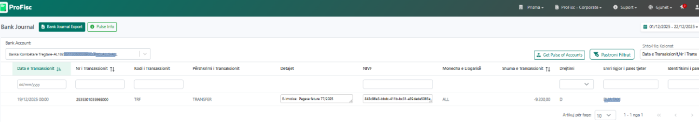
Transaksionet Bankare Ky sherbim mundeson marrjen e statement te llogarise (ve) ne forme elektronike nga BKT direkt ne ProFisc. Statement mund te konsultohet ne nderfaqen e Profisc me avantazhin e filtrave te shumte te kerkimit; mund te exportohet ne csv apo te dergohet drejt sistemit ERP te klientit nepermjet sherbimeve API te ProFisc. Per kete qellim: 1. ProFisc mundeson regjistrimin e informacionit te llogarise (ve) bankare per te cilat klienti deshiron te marre kete sherbim. 2. Keto llogari bankare duhet te jene cilesuar nga klienti ne llogarine e tij E-Banking ne BKT si llogari per te cilat mund te merret ky sherbim (Pulsi i Llogarise ne E-Banking). 2. Transaksionet mundesohen nga data 1 e muajit korrent deri ne daten paraardhese asaj te kerkeses. Ne rast se kerkesa nga Profisc dergohet diten e pare te punes se muajit, atehere transaksionet nga BKT mundesohen per tere muajin paraardhes. Per me shume informacione ju lutemi vizitoni: https://help.profisc.al/transaksionet-bankare-ne-profisc-pulsi-i-llogarise/
7/8

Slide 17
Bank Statement This service enables the receipt of statements in electronic form from BKT directly in ProFisc. The statement can be consulted in the Profisc interface with the advantage of multiple search filters; it can be exported to csv or sent directly to the client's ERP through ProFisc API services. For this purpose: 1. Profisc enables the registration of bank accounts information, for which the client wants to receive this service.
2. These bank accounts must be specified by the client in his E-Banking account in BKT as accounts for which this service can be received (Pulse of Account service in BKT).
2. Transactions are enabled from the day 1st of the current month until the date preceding the request. If the request from ProFisc is sent on the first working day of the month, then transactions from BKT are enabled for the entire previous month. For more information, please visit: https://help.profisc.al/transaksionet-bankare-ne-profisc-pulsi-i-llogarise/
8/8

Slide 18
Faleminderit
Thank you
PROFISC SUPPORT TEAM
Email: profisc-support@profisc.al
Tel: +355 67 700 1100
www.prisma.al
Address: Rr. “Tish Daija” Kompleksi KIKA 2, no. 7, Tirana 1001, Albania
https://profisc.al/ https://help.profisc.al/

